Slide 1


Microprocessors and Assembly Language Spring 2020
Hamed Farbeh
farbeh@aut.ac.ir
Department of Computer Engineering
Amirkabir University of Technology
Lecture 22

Slide 2
Copyright Notice
Parts (text & figures) of this lecture are adopted from:
Arm Assembly Language Programming and Architecture, Volume 1, 1st edition, Muhammad Ali Mazidi, Sarmad Naimi, and Sepehr Naimi, MicroDigitalEd, 2013.
Microprocessors and Assembly Language, Spring 2020, AUT, Tehran, Iran

Slide 3

ARM Memory Map, Memory Access, and
Stack
Microprocessors and Assembly Language, Spring 2020, AUT, Tehran, Iran

Slide 4
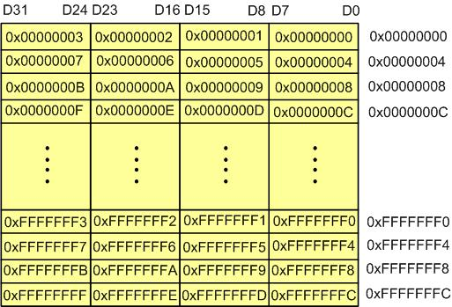
Memory Addressing
Memory Byte Addressing in ARM
Microprocessors and Assembly Language, Spring 2020, AUT, Tehran, Iran

Slide 5
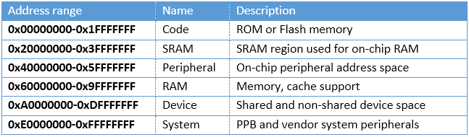
Memory Addressing
Sample Memory Space Allocation in ARM
Microprocessors and Assembly Language, Spring 2020, AUT, Tehran, Iran

Slide 6
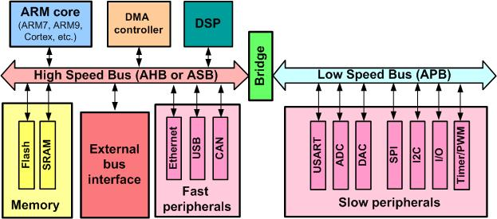
AHB and APB buses
AHB: advanced high-performance bus
Connects CPU to RAM, ROM, …
APB: advanced peripherals bus
Dedicated for communication with the on-chip peripherals
timers, ADC, UART, SPI, I2C, …
Microprocessors and Assembly Language, Spring 2020, AUT, Tehran, Iran

Slide 7
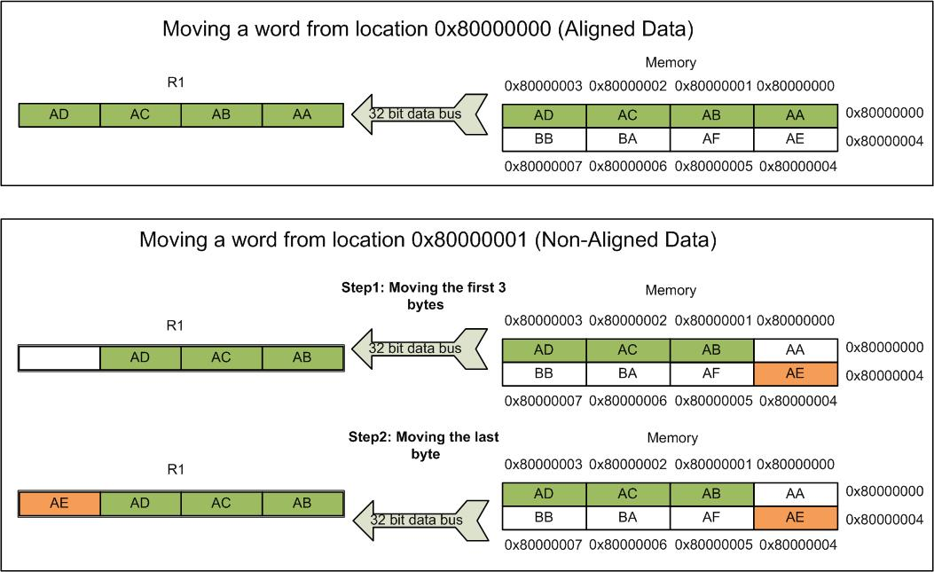
Data Misalignment in SRAM
Compilers make sure that instructions are always aligned
Placement of data in SRAM can be nonaligned
Memory access penalty
Microprocessors and Assembly Language, Spring 2020, AUT, Tehran, Iran

Slide 8
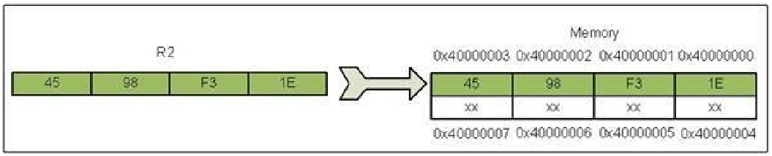
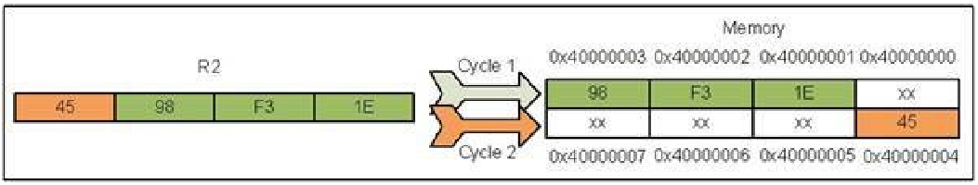
Data Misalignment in SRAM
LDR R1, =0x40000000 ; R1=0x40000000
LDR R2, =0x4598F31E ; R2=0x4598F31E
STR R2, [R1] ; Store R2 to location 0x40000000
ADD R1, R1, #1 ; R1 = R1 + 1 = 0x40000001
STR R2, [R1] ; Store R2 to location 0x40000001
Microprocessors and Assembly Language, Spring 2020, AUT, Tehran, Iran

Slide 9
Advanced Indexed Addressing Mode
Base plus offset addressing modes
Pre-indexed addressing mode with fixed offset
LDR R5, =0x55667788
LDR R1, =0x10000000; load the address of first location
STR R5, [R1] ; store R5 to location 0x10000000
STR R5, [R1, #4]; store R5 to location 0x10000000 + 4 (0x10000004)
STR R5, [R1, #8]; store R5 to location 0x10000000 + 8 (0x10000008)
STR R5, [R1, #0x0C]; store R5 to location 0x10000000 + 0x0C (0x1000000C)
Microprocessors and Assembly Language, Spring 2020, AUT, Tehran, Iran

Slide 10
Advanced Indexed Addressing Mode
Base plus offset addressing modes
Pre-indexed addressing mode with writeback and fixed offset
The calculated pointer is written back to the pointing register
LDR R1, =0x10000000 ; load the address of first location
STR R5, [R1] ; store R5 to location 0x10000000
STR R5, [R1, #4]!; store R5 to location 0x10000000 + 4 (0x10000004)
; writeback makes R1 = 0x10000004
STR R5, [R1, #4]!; store R5 to location 0x10000004 + 4 (0x10000008)
; writeback makes R1 = 0x10000008
STR R5, [R1, #4]!; store R5 to location 0x10000008 + 4 (0x1000000C)
; writeback makes R1 = 0x1000000C
Microprocessors and Assembly Language, Spring 2020, AUT, Tehran, Iran

Slide 11
Advanced Indexed Addressing Mode
Base plus offset addressing modes
Post-indexed addressing mode with fixed offset
Update pointer after the load/store operation
STR R1, [R2], #4 ; store R1 into memory pointed to by R2 and then write back R2 + 4 to R2
LDRB R5, [R3], #1 ; load a byte from memory pointed to by R3 and then write back R3 + 1 to R3
Microprocessors and Assembly Language, Spring 2020, AUT, Tehran, Iran

Slide 12
Advanced Indexed Addressing Mode
Pre-indexed address mode with offset of a shifted register
Simple format
LDR Rd, [Rm, Rn] ; Rd is loaded from location Rm + Rn of memory
STR Rs, [Rm, Rn] ; Rs is stored to location Rm + Rn of memory
General format
LDR Rd, [Rm, Rn, <shift>] ; (Shifted Rn) + Rm is used as the address
STR Rd, [Rm, Rn, <shift>] ; (Shifted Rn) + Rm is used as the address
LDR R1, [R2, R3, LSL #2] ; R2 + (R3 × 4) is used as the address
STR R1, [R2, R3, LSL #1] ; R2 + (R3 × 2) is used as the address
STRB R1, [R2, R3, LSL #2] ; R2 + (R3 × 4) is used as the address
; least significant byte of R1 is stored at location R2 + (R3 × 4)
LDR R1, [R2, R3, LSR #2] ; R2 + (R3 / 4) is used as the address
Microprocessors and Assembly Language, Spring 2020, AUT, Tehran, Iran

Slide 13
Advanced Indexed Addressing Mode
Writeback sign (!) in pre-indexed ld/st with scaled register
LDR R1, [R2, R3, LSL #2]!; R2 + (R3 × 4) is used as the address,
; content of location R2 + (R3 × 4) is loaded to R1
; R2 = R2 + (R3 × 4) (R2 is updated.)
STR R1, [R2, R3, LSL #1]!; R2 + (R3 × 2) is used as the address
; R1 is stored to location R2 + (R3 × 2)
; R2 = R2 + (R3 × 2) (R2 is updated)
Scaled register post-indexed
STR R1, [R2], R3, LSL #2; store R1 at location R2 of memory ; and write back R2 + (R3 × 4) to R2. LDR R1, [R2], R3, LSL #2; load location R2 of memory to R1 ; and write back R2 + (R3 × 4) to R2
Microprocessors and Assembly Language, Spring 2020, AUT, Tehran, Iran

Slide 14
To be Continued!
Microprocessors and Assembly Language, Spring 2020, AUT, Tehran, Iran

